Slide 1
Module2_Part3 Textbook : Operating Systems Concepts by Silberschatz
Operating SYSTEMS

Slide 2
Interprocess communication
Processes executing concurrently in the operating system may be
independent processes
cooperating processes.
A process is independent if
- it cannot affect or be affected by the other processes executing in the system.
-it does not share data with any other process .
A process is cooperating if
-it can affect or be affected by the other processes executing in the system.
-it shares data with other processes

Slide 3
Interprocess communication
Reasons for providing an environment that allows process cooperation:
Information sharing. Since several users may be interested in the same piece of
information (for instance, a shared file), we must provide an environment to allow
concurrent access to such information.
Computation speedup. If we want a particular task to run faster, we must break it into
subtasks, each of which will be executing in parallel with the others. Notice that such a
speedup can be achieved only if the computer has multiple processing cores.
Modularity. We may want to construct the system in a modular fashion, dividing the
system functions into separate processes or threads.
Convenience. Even an individual user may work on many tasks at the same time. For
instance, a user may be editing, listening to music, and compiling in parallel.

Slide 4
Interprocess communication
Cooperating processes require an interprocess communication (IPC) mechanism that
will allow them to exchange data and information.
Two fundamental models of interprocess communication:
shared memory
message passing.
In the shared memory model
a region of memory that is shared by cooperating processes is established.
Processes can then exchange information by reading and writing data to the shared region.
In the message-passing model,
communication takes place by means of messages exchanged between the cooperating
processes.

Slide 5
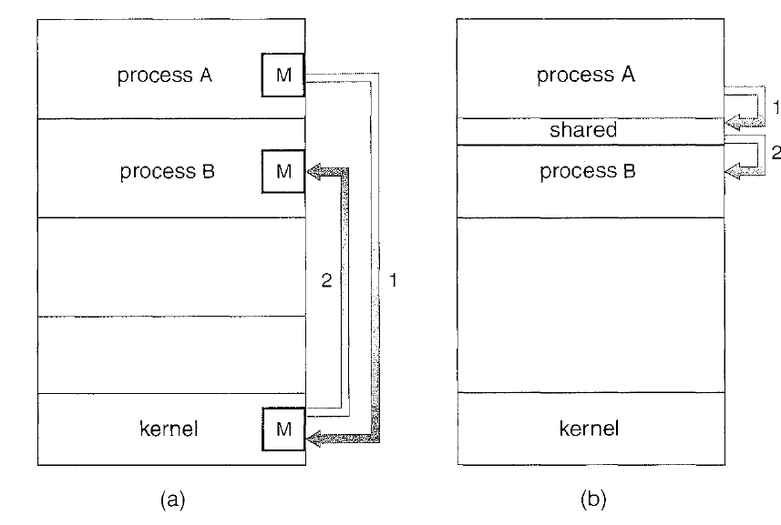
Interprocess communication
a)Message passing b)shared memory
Abraham Silberschatzs

Slide 6
Shared memory and Message passing
Message passing
-is useful for exchanging smaller amounts of data.
-is easier to implement than is shared memory for intercomputer communication.
-are typically implemented using system calls and thus require the more time-consuming task
of kernel intervention.
Shared memory allows
-maximum speed and convenience of communication.
-is faster than message passing, In contrast,
- system calls , only to establish shared-memory regions. Once shared memory is
established, all accesses are treated as routine memory accesses, and no assistance from the
kernel is required.

Slide 7
Shared memory systems
Interprocess communication using shared memory requires ,communicating processes to
establish a region of shared memory.
Typically, a shared-memory region resides in the address space of the process, creating the
shared memory segment.
Other processes that wish to communicate using this shared memory segment must attach it to
their address space.
In shared memory system , cooperating processes can exchange information by reading and
writing data in the shared areas.
The form of the data and the location are determined by these processes and are not under the
operating system's control.
The processes are also responsible for ensuring that they are not writing to the same location
simultaneously.

Slide 8
Shared memory systems
let's consider the producer-consumer problem, which is a common paradigm for
cooperating processes. A producer process produces information that is consumed by a
consumer process.
One solution to the producer–consumer problem uses shared memory. To allow producer and
consumer processes to run concurrently, we must have available a buffer of items that can be
filled by the producer and emptied by the consumer.
This buffer will reside in a region of memory that is shared by the producer and consumer processes.
A producer can produce one item while the consumer is consuming another item.
The producer and consumer must be synchronized, so that the consumer does not try to consume an item that has not yet been produced.
The producer should produce data only when the buffer is not full.
Accessing memory buffer should not be allowed to producer and consumer at the same time.

Slide 9
Shared memory systems
Two types of buffers can be used.
unbounded buffer places no practical limit on the size of the buffer. The consumer may have to wait for new items, but the producer can always produce new items.
bounded buffer assumes a fixed buffer size. In this case, the consumer must wait if the buffer
is empty, and the producer must wait if the buffer is full.

Slide 10
Shared memory systems
Bounded buffer , inter process communication using shared memory.
The following variables reside in a region of memory shared by the
producer and consumer processes:
Shared data
#define BUFFER_SIZE 10
typedef struct {
. . .
} item;
item buffer[BUFFER_SIZE];
int in = 0;
int out = 0;

Slide 11
Bounded buffer , inter process communication using shared memory.
The shared buffer is implemented as a circular array with two logical pointers: in and out.
in points to the next free position in the buffer;
out points to the first full position in the buffer.
The buffer is empty when in == out;
the buffer is full when ((in + 1)% BUFFER SIZE) == out.

Slide 12
Producer consumer problem using shared memory
The producer process has a local variable next produced in which the new item to be
produced is stored.
item next_produced;
while (true) {
/* produce an item in next produced */
while (((in + 1) % BUFFER_SIZE) == out)
; /* do nothing */
buffer[in] = next_produced;
in = (in + 1) % BUFFER_SIZE;
}

Slide 13
Producer consumer problem using shared memory
The consumer process has a local variable next consumed in which the item to be
consumed is stored.
item next_consumed;
while (true) { while (in == out)
; /* do nothing */ next_consumed = buffer[out];
out = (out + 1) % BUFFER_SIZE;
/* consume the item in next consumed */
}

